Slide 1
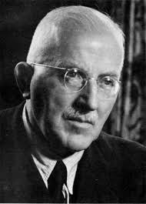
Pt. 2: Polymers Lecture #5 Introduction to polymers
Polymers = ‘macromolecules’ or ‘chain’ molecules
Types of polymers
Shape/size of ‘freely jointed（自由联合）’ polymer: Random walk ‘coil’
Real coils, Kuhn’s segment, C∞
H Staudinger
Nobel Prize 1953

Slide 2
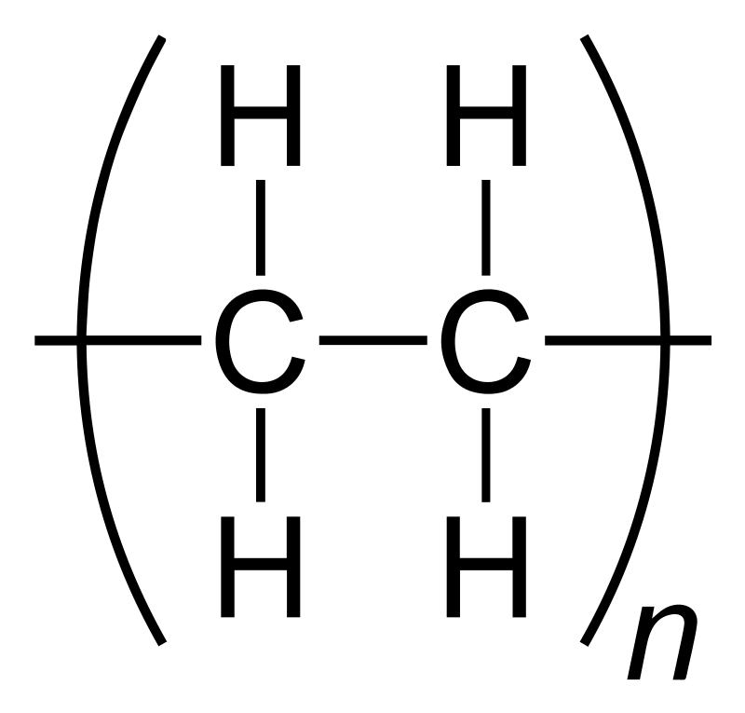
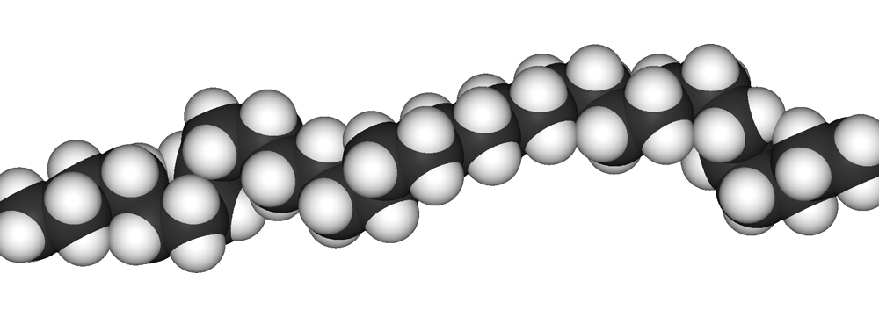
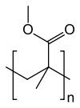



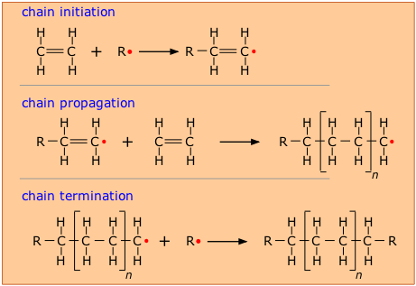
Polymers: Examples
Often (not always) saturated C backbone,
different conventions on notation
N (or n) >> 1: ‘Degree of polymerisation’（聚合度）
n distribution ‘Polydispersity’（多分散）, shape and average depend
on synthetic route. Number / weight averages M_{N}, M_{W}
Polymer ‘chains’ are not (usually) straight!
(180º -109.5º) = 70.5º bond angle + large scale ‘coiling’
Monomer vs. repeat unit:
Monomer: reactive molecule before polymerisation（单体是反应前的分子）
Repeat unit: repeated element along the polymer backbone
Polyethylene (PE)
P5.1a
Nylon 6-6
PMMA
Amylose
PDMS
Ethylene polymerisation:
Monomer ethylene,
Unsaturated = reactive
(double bond)
Product: Polyethylene
saturated
Poly(alt fluorene-bisthiophene) copolymer

Slide 3
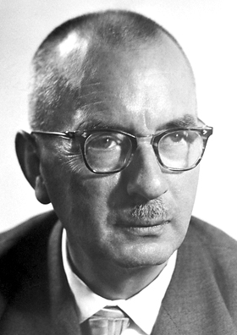
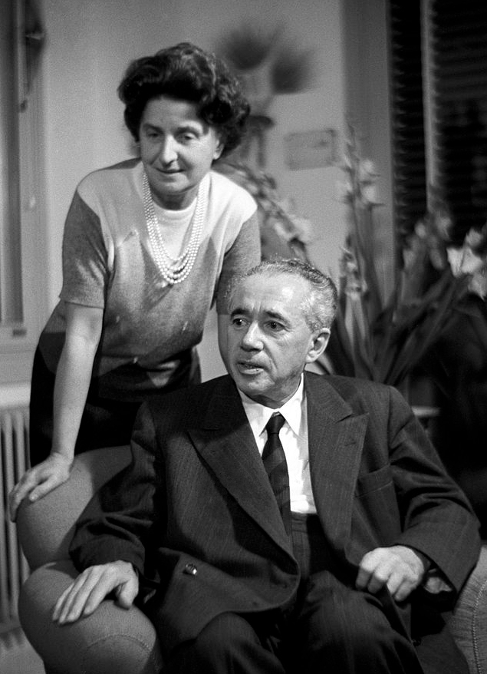
Stereochemistry（立体化学）
isotactic（全同）
syndiotactic（间同）
K Ziegler, G Natta
Nobel Prize 1963
atactic（无规）
example is polypropylene

Slide 4
‘Linear’
Comb or graft copolymer
There are many more possibilities!
Star
(ABA) triblock copolymer（三嵌段）
Branched

Slide 5
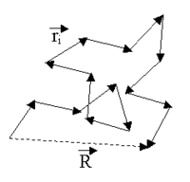
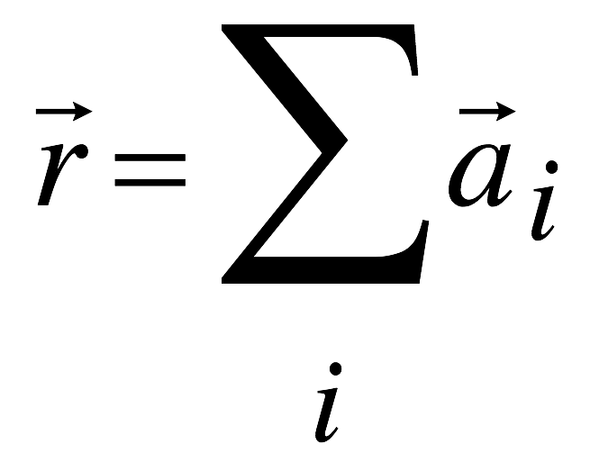
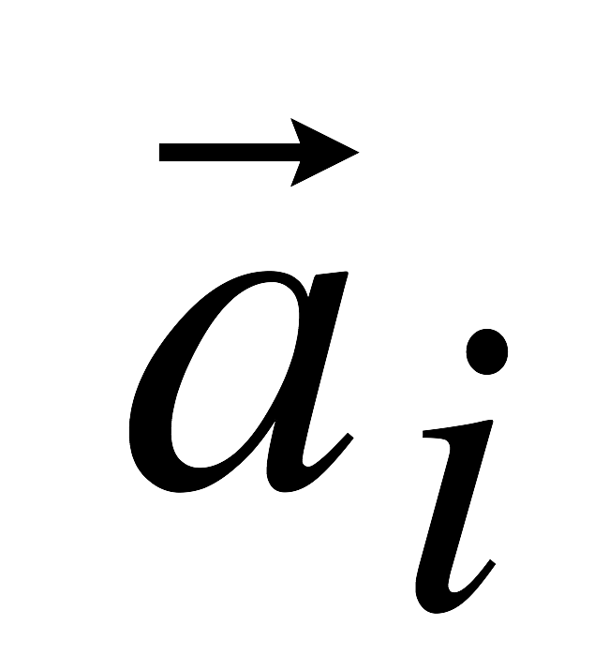
Even ‘Linear’ Polymers aren’t straight
‘end- to- end’ vector r
r ≠ ‘contour length（轮廓长度）’ = Na
Coil volume ≠ Na³
‘Random walk’
(e.g. in solution)
‘freely jointed’ polymer ‘coil’
a: Length of one repeat unit, N: No. of repeat units
Estimate a from bulk density and molecular weight of repeat unit
calculate v of one repeat unit; a = v^{1/3}
Or take a from known chemical bond lengths/angles
P5.1b

Slide 6
The size of a ‘coiled’ polymer chain
First consider one isolated chain
A freely jointed chain is a random walk (like diffusion)
Bond angle restrictions forbid this from being strictly so
End- to end r:
<r> = ?
RMS: <r²>^{1/2} = R ~ N^{1/2}: ‘Scaling law’ for coil size
P5.2
And coil volume ~ R³

Slide 7
End-to-end distance distribution
RMS R ~ N^{1/2} is an average
Probability distribution of R:
‘Gaussian chain’
Boltzmann:
Entropy S = k_{B}lnW
➔
Entropy loss when coiled chain is pulled (or squeezed) away from RMS R

Slide 8
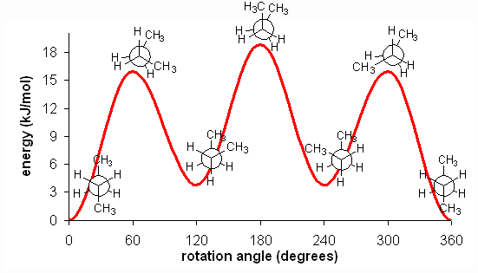
Reality check: Freely jointed !?
Freely jointed assumption for ease of calculation, but…
Stereochemistry tells us this is unrealistic
Adjacent monomers have a given bond angle
For -C-C-C-… backbones: Θ = 180º -‘Tetraeder angle’ = 70.53°
‘Freely rotating’ chain: Θ fixed, free around ‘dihedral angle’（二面角）, φ
Reality: ‘Rotational potential’ V(φ), plus mid- range correlations (‘Pentane（戊烷） effect’)
https://people.ok.ubc.ca/wsmcneil/121/images/butenergy.gif
Notes:
Refer back to slide 6; also page 79 of SCM

Slide 9
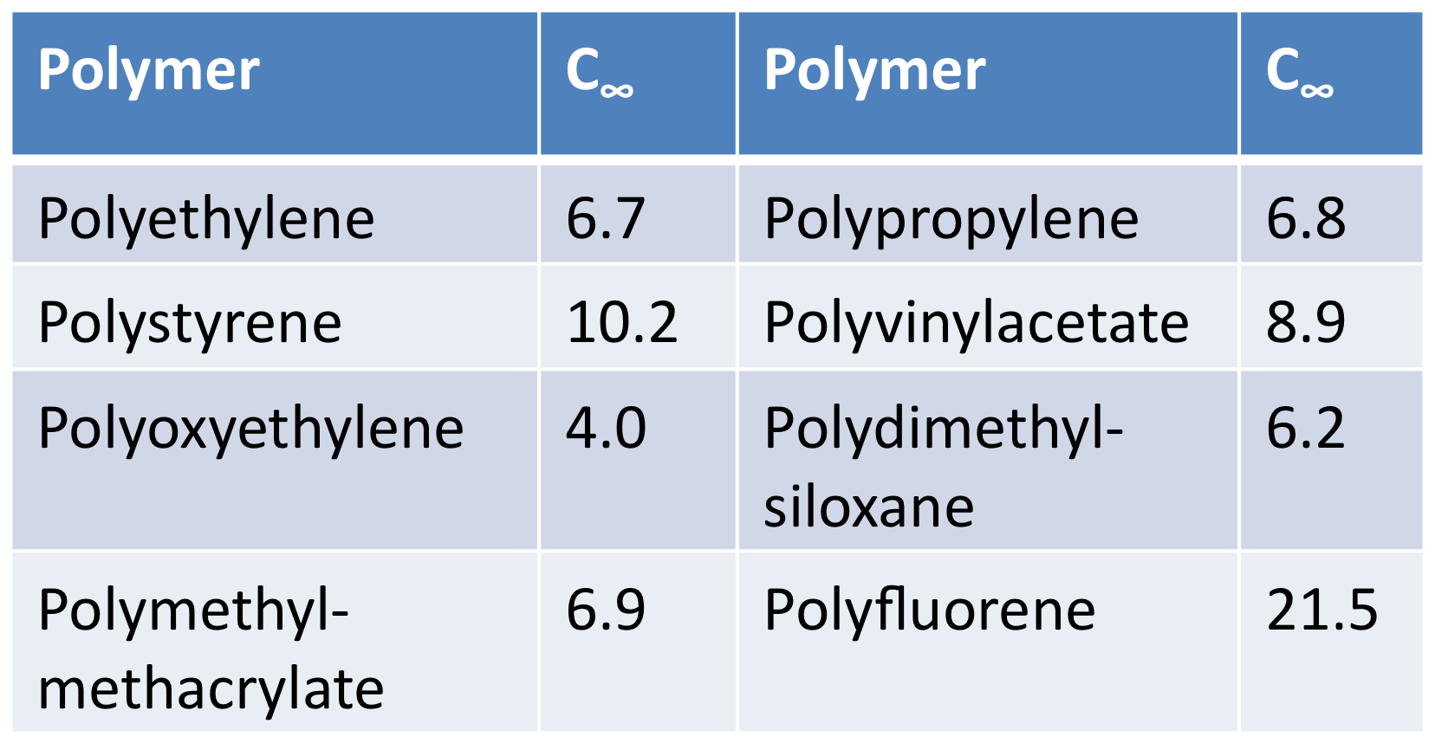
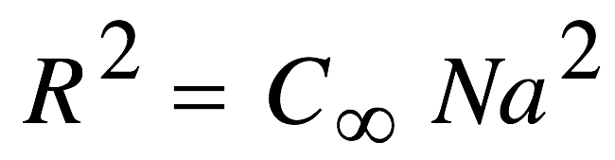
Kuhn’s segment / C∞: Universality
Consider <r²> = N’b²
where b > a = Kuhn’s segment, N’ < N but N’ ~ N
Kuhn’s segment describes loss of correlation over several repeat units
Kuhn’s segments are freely jointed
‘Scaling law’ holds: still R ~ N^{1/2}
Introduce the characteristic ratio, C∞ P5.3
Freely jointed: C∞= 1
Freely rotating: C∞= 2
C∞ measures chain
stiffness（刚性）/flexibility

Slide 10
Summary: Lecture #5 Introduction to Polymers
A wide variety of polymers can be synthesized with different properties and structures
Polymer chemists are pretty clever, respect
Simplistic model of linear chain = freely jointed random walk leads to scaling law, R ~ N^{1/2} P5.4
More realistic view gives different pre- factor, but same scaling R ~ N^{1/2}:
Universal scaling law for linear chains, specifics of particular material are summarised in one factor, characteristic ratio C∞
The material contained within this lecture can be found in SCM chapter 5 up to 5.3.2

Slide 11
Lecture #6 Excluded Volume A guided tour to random walks: The Flory lecture
Excluded volume
Isolated chains, chains in solution, chains in melt
Excluded volume in good, poor, and ‘neutral’ (Θ) solvents
Excluded volume in melts

Slide 12
Excluded volume
Repeat units cannot just cross each other
R = <r²>^{1/2}
‘self- avoiding random walk’ SARW: unlike diffusion
Coil ‘bloated（胀）’ by exclusion: <r²>^{1/2} = R ~ N^{ν} with ν > ½
Long- range interaction far down
the chain
(farther than Kuhn’s segment)
Notes:
One can exemplify the idea in terms of liquid crystals for which shape plays a role. Excluded volume certainly decreases as rods align

Slide 13
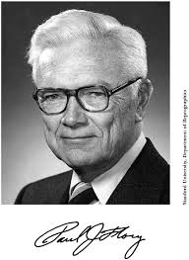
Excluded volume and chain size PJ Flory’s mean- field reasoning for ν
Repeat unit clashes cost energy per clash（碰撞）, U_{cl} = zk_{B}T
Density / concentration c of repeat units within coil: c ~ N/R³ ;
Clashes raise energy/repeat unit by average ~ cU_{cl}
For whole chain, U ~ NcU_{cl} ~ k_{B}TzN² / R³ ➔ U = Ak_{B}TN²/R³
Min. U for max R … But: Entropy depends on R, S(R) ~ R²/N
➔ S(R) = - BR²/N
➔ Helmholtz free energy, F(R) = U -TS = k_{B}T (AN²/R³ + BR²/N)
P6.1 ➔ R ~ N^{3/5}, ν = 3/5 = 0.6
‘fancy’ theory (‘renormalisation group’):
ν = 0.588… P6.2 Nobel Prize 1974

Slide 14
Reality check: Isolated chains?
So far we looked at single, i.e. isolated chain
Real polymer chains are in solution, or in ‘melt’
Solution concentration: ‘Dilute’/ ‘semidilute’ / ’concentrated’ solun., melt
Solvent quality: ‘Good’ to ‘poor’ solvent

Slide 15
Interlude: Measuring concentration
Concentration ‘c’: Usual unit ‘M’ (molarity)
1 M = 1 mole (substance) / 1 litre (solution); mM, μM, … P6.3
But : 1 mole polymers or 1 mole repeat units?
Polymer solutions: c usually in g/L or mg/mL
Alternative: Volume fraction, Φ
0 < Φ < 1, dimensionless, often used for theory (Ch. 3)
Φ: Volume fraction occupied by repeat units
Convert btwn c (g/L) and Φ via density
Φ_{coil}: Vol. frac. occupied by coils Φ_{coil} >> Φ Solvent trapped in coil counts towards Φ_{coil}, but not Φ
Φ_{coil} depends on N and ν as well as c/Φ

Slide 16
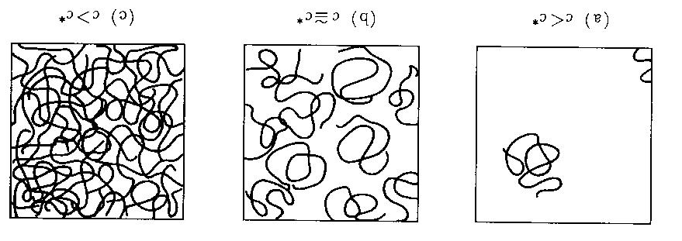
Dilute vs. concentrated solutions
c = 0 c < c*: c ≈ c*: c > c*: c >> c*:
solvent dilute solution semi- dilute concentrated. melt (c=ρ)
Φ_{coil} = 1 Φ = 1
‘Overlap concentration’ c* ➔ Above c* coils interpenetrate: Φ_{coil}(c*) = 1
Very different flow/viscoelastic properties below/above c*
Caution claiming ‘dilute’ solution: c* may be surprisingly small P6.4

Slide 17
Dilute solun. in ‘good’ solvent
‘Good’ solvent: Repeat unit ‘enjoys’ contact with solvent (i.e., contact with solvent is enthalpically preferred over contact with other repeat unit)
Dilute solun.: Ignore other chains
Flory excluded volume reasoning applies
R ~ N^{3/5}

Slide 18
Dilute solun. in Θ solvent
Flory concept: Θ solvent: U_{Cl} (excluded vol.) exactly balanced by slightly favourable repeat – unit / repeat unit interaction over repeat unit / solvent interaction.
Excluded volume effect is cancelled
Θ solvent = ‘neutral’ solvent
Again, R ~ N^{1/2} scaling: ‘Ideal’ (random walk) chains
Interactions T- dependent ➔ Θ condition for a specific polymer/solvent is met at only one specific temperature
‘Θ Temperature’
Notes:
Note that eq 5.16 is wrong. It should have +zNV(ε_{ps} - ε_{ss}). The term in the book misses the V and has a + where a - should be.
Discuss other values of χ (3/5 scaling for small χ and globules for large χ)
We’ll need to define chi here. Refer to phase separation part for chi derivation there, but it is easy if we just add the energies. The derivation reminds us that we need a minus sign

Slide 19
Flory scaling laws found in real data
Log/log plot scaling exponent → straight line slope
PS in good solvent: slope 0.59 (Flory mean field says: 0.6)
PS in Θ solvent: slope 0.5 (Flory says: 0.5)

Slide 20
Dilute solun. in ‘poor’ solvent
‘Poor’ solvent: Repeat unit ‘avoids’ contact with solvent (i.e., contact with other repeat unit is preferred over contact with solvent)
Coil ‘collapses’: Coil- to- globule transition
Globule: Dense ‘ball’ with no trapped solvent inside
R ~ N^{1/3}
Precipitation or colloid, no longer proper ‘solution’

Slide 21
Excluded Volume in melt (?)
Prior ‘excluded volume’ reasoning was for dilute solution
In melt: Effectively no excluded volume
‘clash’ reasoning falls down: Avoiding clashes with repeat units of own chain only leads to clashes with repeat units of other chain, which is no different in terms of energy
Again, R ~ N^{1/2} scaling: Ideal random walk
Melt is like Θ solvent at all T (or rather, vice versa)
Reasoned by Flory in 1949 already, proved in 1970s by neutron scattering on deuterated chains in non- deuterated melt
J P Cotton et al., Macromolecules 7, 863 (1974)

Slide 22
Summary: Lecture #6 Excluded Volume
Excluded volume ‘bloats’ scaling exponent ½ → ⅗
Applies in good solvent, but compensated in ‘Θ’ solvent (at Θ temperature)
½ scaling exponent again at Θ
Θ condition specific to polymer, solvent, temperature
Melt mimicks Θ solvent at all T (Better: Θ solvent mimicks melt but only at one T)
Coil → globule (exponent ½ → ¹/₃) in poor solvent
The material contained within this lecture can be found in SCM chapter 5.3.3, 5.3.4

Slide 23
Lecture #7
Polymer mechanical properties
Rubbers and their elasticity
Viscoelasticity and rheology
Moduli
Creep compliance and stress relaxation modulus
Time- frequency - temperature superposition

Slide 24
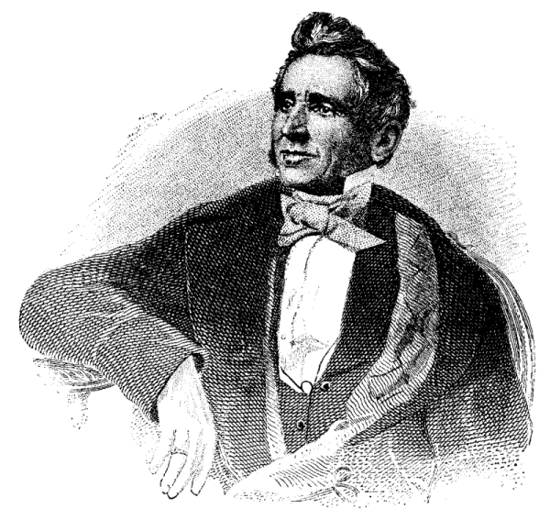
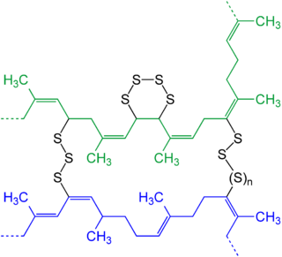
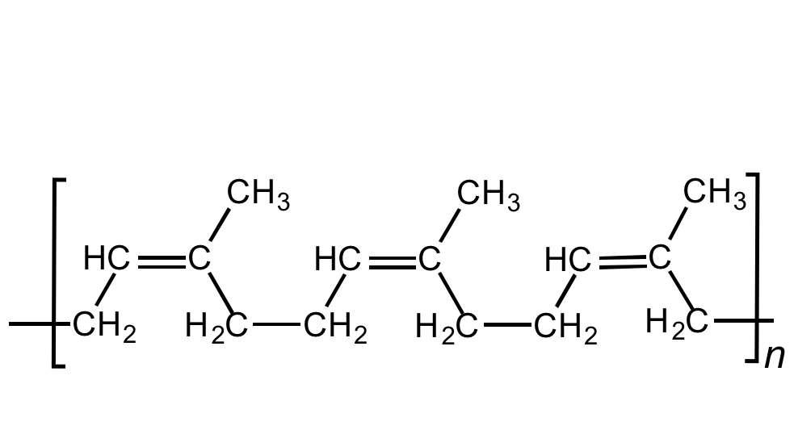
Rubber
Rubber: Lightly crosslinked（交联） polymer
Above T_{G}
aka ‘Elastomer’ (in engineering)
Natural poly(cis- isoprene)
Charles Goodyear 1842
Δ, Sulfur
Random Crosslinks btwn chains
➔ 3D Network above T_{g}
‘Lightly’ crosslinked: Many Kuhn segments btwn Xlinks, above T_{G}
Soft material, can stretch many times its original length w/out failure
But: Elastic, not viscous → will snap back after stretching

Slide 25

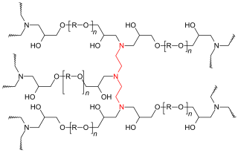
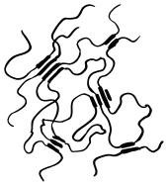
Rubber’s relatives
Highly Xlinked polymers: Thermoset or Duroplast
Derived from a ‘prepolymer’ = thermosetting resin or 2- component resin/hardener
Hard, brittle, no T_{G}
‘hard’ soft matter, e.g. sheet metal substitute
or strong glue
e.g. ‘epoxy resin’ 2- component glue
Physically Xlinked
Polymers
‘Thermoplastic
Elastomers’
Gels: Lightly crosslinked polymer swollen with solvent (e.g. water)

Slide 26
Rubber Elasticity
Low Xlink density: Segments btwn Xlinks >> Kuhn segment.
Treat as freely jointed Gaussian coils.
Stretching the rubber costs no internal energy, but entropy
We recall the entropy of a single Gaussian coil
Stretch the coil λ- fold in 1 direction:
3 dim. (x,y,z):
Stretch in (say) x direction ➔ Shrink in y, z direction
Assume const.V: λ_{x} = λ, λ_{y} = λ_{z} = 1/√λ

Slide 27
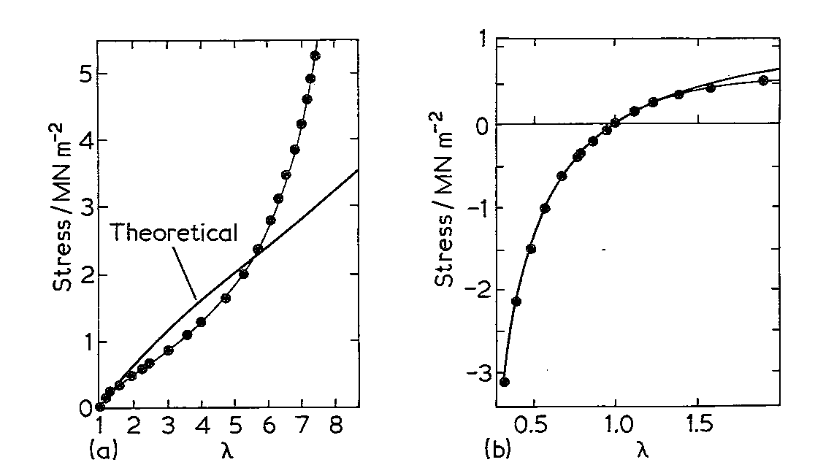
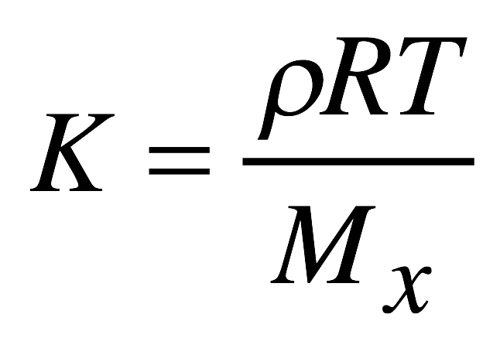

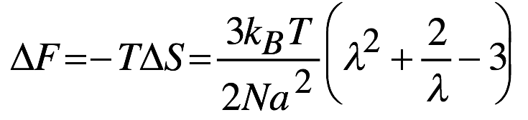
Rubber Elasticity
Internal energy U independent of λ
N = Nº. of Kuhn seg’s btwn X links
Stress σ = 1/Al dΔF/dλ
σ = K (λ – 1/λ²) with a modulus, K
With a few more assumptions (micro → macroscopic)
= density, M_{x}: Mol. Wt. btwn X links
Reality check:
Not fully quantitative
Key point: ‘Entropy Elasticity’, K ~ T
typically, K << E, G for conventional solid

Slide 28
Viscoelasticity: Creep and stress relaxation
Stress and strain have complicated temporal behaviour
Creep compliance: J(t) = ε(t)/σ₀ after sudden stress at t = 0
Stress relaxation modulus: G(t) or E(t) = σ(t)/ε₀ after sudden strain at t = 0
Strain
Stress
σ₀/η
σ₀/G
time
time
P7.1
e.g. KWW: G(t) = G(0)exp[-(t/τ)^{β}]

Slide 29
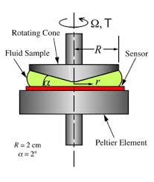
Oscillatory strain
Important means of studying rheological properties of polymers
Here ε(t) = ε₀cos(ωt)
‘Cone and plate’ rheometer
Notes:
Elastic modulus links to solid behaviour, whilst loss modulus to Newtonian behaviour. For a Hookean solid, sigma = G epsilon cos(omega t); I.e. in phase. One can draw a parallel with a Newtonian fluid for which we have to get the shear strain as d.epsilon/dt. The cos becomes a sin and we have a 90° phase difference.

Slide 30
Oscillatory stress/strain
ε(t) = ε₀cos(ωt) ➔ stress response σ(t)
σ(t)/ε₀ = G’(ω)cos(ωt) - G”(ω)sin(ωt)
Complex modulus, G*(ω) = G’(ω) + iG”(ω) (Note: G’, G” are real/imaginary part - not derivatives)
Storage modulus G’
Real part, quantifies part of σ in phase with ε, like in a solid => energy stored
Loss modulus G”
Imaginary part, quantifies part of σ 90º out- of phase with ε => ~ dε/dt like in liquid, energy dissipated.
Loss tangens, tanδ = G”/G’
Relation G(t) / G(ω):
Links time- to frequency domain P7.2

Slide 31
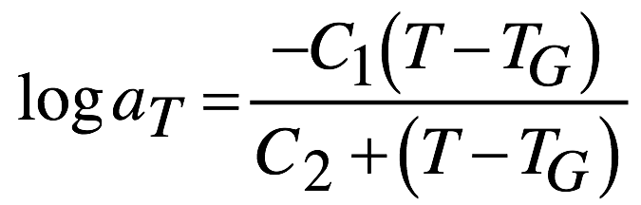
Remember WLF
Relaxation times / moduli T dependent
Can be expressed with ‘shift factor’ a_{T}
Stress relaxation modulus shifts with T:
G(t,T) = G(a_{T}t, T_{G})
C₁ = 17.4 and C₂ = 51.6 K
Links time- and Temperature domains
Frequency ←(Fourier)→ time ←(WLF)→Temperature all linked up
Practically, WLF useful to extend effective f/time domain
beyond instrumental limits – practical rheometers have heaters

Slide 32
Summary: Lecture #7 Polymer mechanical properties
Rubbers aka elastomers: Lightly crosslinked polymers
Entropy- elastic behaviour (unravelling Kuhn coils)
Low modulus, but increases ~ T
Different from ‘Duroplast’: Heavily crosslinked
Polymer viscoelasticity:
- Creep and stress relaxation
Time (t) / frequency (f, ω)- dependent experiments linked by FT, G (t) ←→ G*(ω)
Time / temperature dependent expt’s linked by WLF
to be continued…
The material contained within this lecture can be found in SCM chapter 5 section 5.4 (rubber) and 5.5.1 (viscoelasticity)

Slide 33
Lecture #8 Entanglements and reptation The de Gennes lecture
Rubbery modulus plateau in linear polymers
Universal polymer mechanics
Entanglements and reptation tubes
Relaxation times and diffusion coefficients

Slide 34
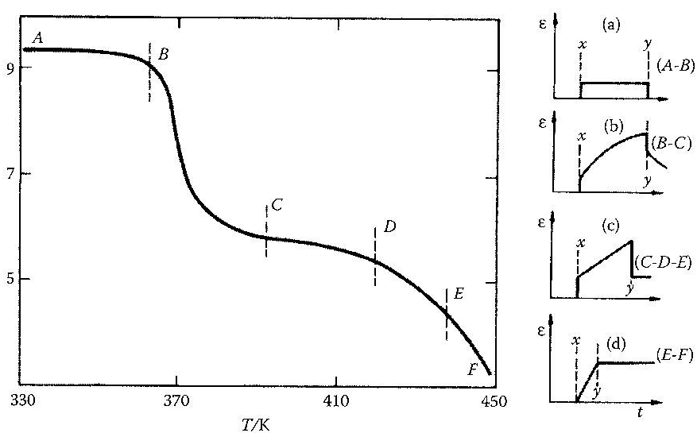
Temp. domain, G’(T) for linear polymers: 5’regions’
Log G
(PS)
Below B: ‘Glassy’ state. Spring- like solid, high G, no creep.
B - C: ‘Glass transition’ (T_{g}) @ B, ≈ 1000x drop in G over 30K
‘retarded highly elastic’: Quick strain plus creep.
C - D: ‘Rubbery’, quick strain + slow flow, G ≈ const. over 30K
D - E: ‘Rubbery flow’, G drops with T, quick strain + flow.
Above E: Viscous liquid. Only flow.
Part- crystalline: Higher G above T_{g} up to T_{M}, then sudden drop
Lightly crosslinked: C – D region extends to higher T, similar G
Why rubbery?
Linear, not Xlinked
Typical for Polymer

Slide 35
Time domain: Stress relaxation modulus G(t)
Stress relaxation modulus displays 3 regions
Transition glass to rubber- elastic behaviour
Intermediate Rubbery Plateau modulus: No stress relaxation
only for polymers, not for eg. window glass
Terminal region: Stress relaxes, viscous flow
Molecular mass / N : shifting of terminal region time
logG(t)
log(time)
Minimum N (N_{ent}) needed for plateau modulus

Slide 36
Characteristic and universal polymer mechanics
‘Polymer’: N > N_{ent}:
Terminal time τ_{T} ~ N^{3.4}
logG(t)
‘Plateau’ modulus
G_{p} ≠ f(N)
G_{p} ≈ rubber
log(time)
Above critical N = N_{ent}:
G_{p}, independent of N
η ~ N^{3.4}
Scaling universal for all (linear)
polymers
But different N_{ent} ←→ C∞
!?
η = G_{p}τ_{T}
log (η)
η ∝ N^{3.4}
η ∝ N
log N
N_{ent}

Slide 37
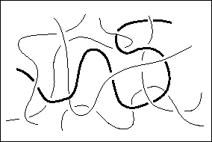
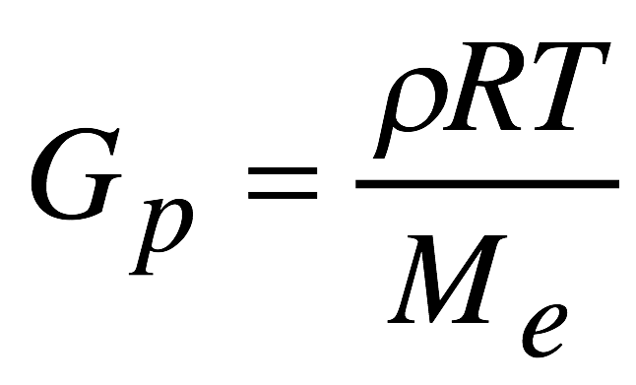
Entanglements
N > N_{ent}: Chains in melt entangle
‘temporary crosslinks’
t < τ_{T} : Rubber- like behaviour, G_{p} plateau
t > τ_{T} : Entanglements ‘slip’, viscous flow
From rubber elasticity: ρ: Density
M_{e} = N_{ent}M_{repeat}
M_{e}: ‘Entanglement molecular weight’
Chemistry: Polymer = ‘long’ chain molecule – but how long is ‘long’?
Physics: ➔ Answer!
Polymers are chain molecules long enough to entangle (M > M_{e})
P8.1

Slide 38
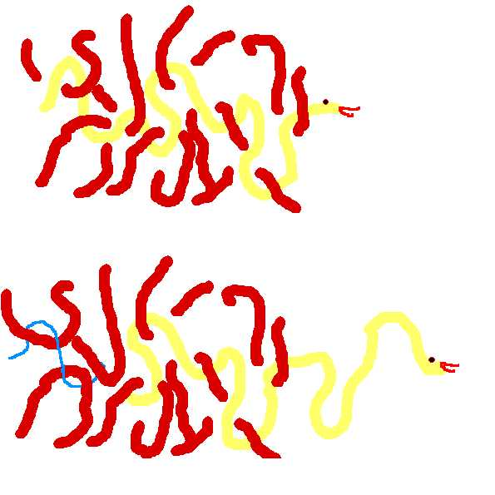
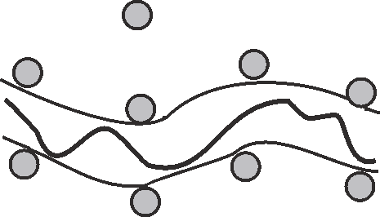
The reptation tube model
Entanglements define a ‘tube’ confining polymer’s Brownian motion
Polymer diffuses along the tube: ‘reptation’
Relevant length scale: Contour length L ~ N (not R ~ N^{1/2})
τ_{T} given by time to escape old /
‘find’ new tube
from T. Russ et al. Eur. Phys. J. E 4 419-33 (2001).
Notes:
Well worth discussing that a tube is not defined by a dense sea of polymers Consider polystyrene as an example. This can introduce the importance of shorter relaxation times and Rouse modes

Slide 39

Terminal time (τ_{T}) scaling
Diffusion law: L = √Dt ➔ τ_{T} =L²/D_{tube}
L = contour length ~ N; L² ~ N²
Einstein relation: D = k_{B}Tμ
= mobility in tube; μ_{tube} ~ 1/N as drag adds up
D ~ 1/N
τ_{T} ~ N ³ vs. N^{3.4}
Dynamic scaling law
P G de Gennes, Nobel Prize 1991
Notes:
Remember eta = Gp tau where tau is terminal time and Gp plateau modulus
One can also write Dtube as kTN1/N where N1 is the number of obstacles, and 1/N1 = 1/Nent + 1/Nxlink

Slide 40
Limitations of simple reptation model
We can see that the agreement with experiment is good but not perfect
Viscosity / τ_{T} scales as N^{3.4} experimentally, not N³
Two possible mechanisms give rise to a greater power law behaviour
Constraint release
The surrounding chains are also moving, and sometimes leave
End- to end length fluctuations
a√N is only an average end-to-end distance
This fluctuates and gives the chain more possible diffusion routes
Notes:
The constitutive equations to calculate eta are belong the level of this course

Slide 41
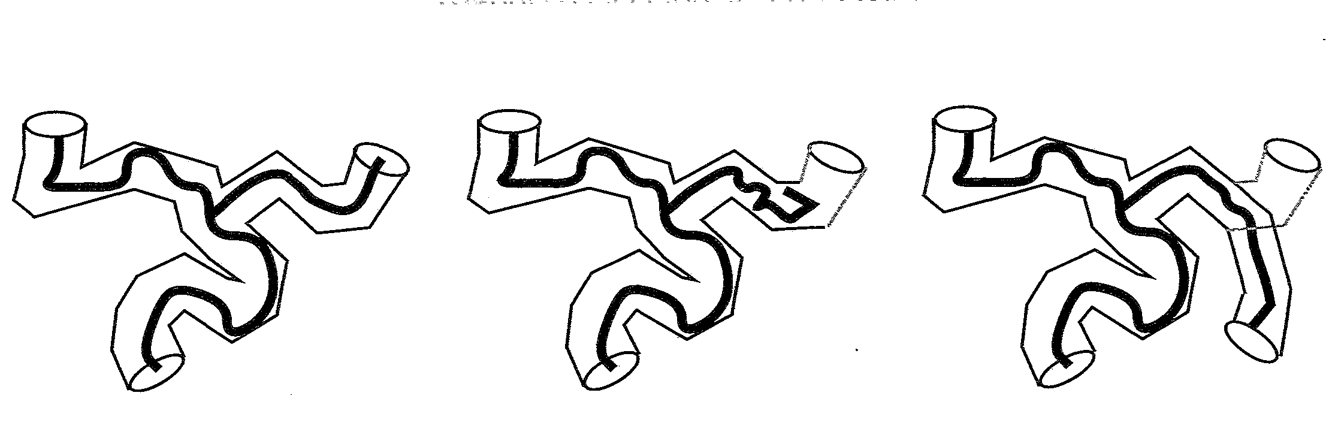
Branched chains
May be chemically similar, but different architecture leads to very different mechanical / flow properties. τ_{T} ≠ N^{3.4}
Configuration changes due to R fluctuations, τ expt’al with N

Slide 42
Summary: Lecture #8 Entanglements and reptation
Linear polymer melts show rubbery behaviour without crosslinks
Minimum No. of repeat units needed ➔ defines ‘Polymer’
Plateau modulus independent of N, but terminal time τ_{T}~ N^{3.4}
Rubbery behaviour explained by ‘entanglements’ = temporary Xlinks
Diffusion of polymers confined to a ‘tube’ by entanglements
Diffusion along tube contour = ‘reptation’
Approximately explains dynamic scaling law τ_{T}~ N^{3.4}
Different for branched chains
The material contained within this lecture can be found in SCM chapter 5 section 5.5.6

